Slide 1

Controllers
Sit Dolor Amet

Slide 2

Industrial PC
Designed to beused specifically in an industrial environment.
Pros:
Long Lifecycle
Robust
High Efficiency
Cons:
High Cost
Regular Maitainance

Slide 3
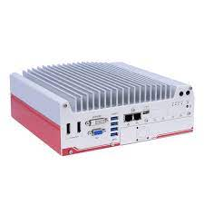
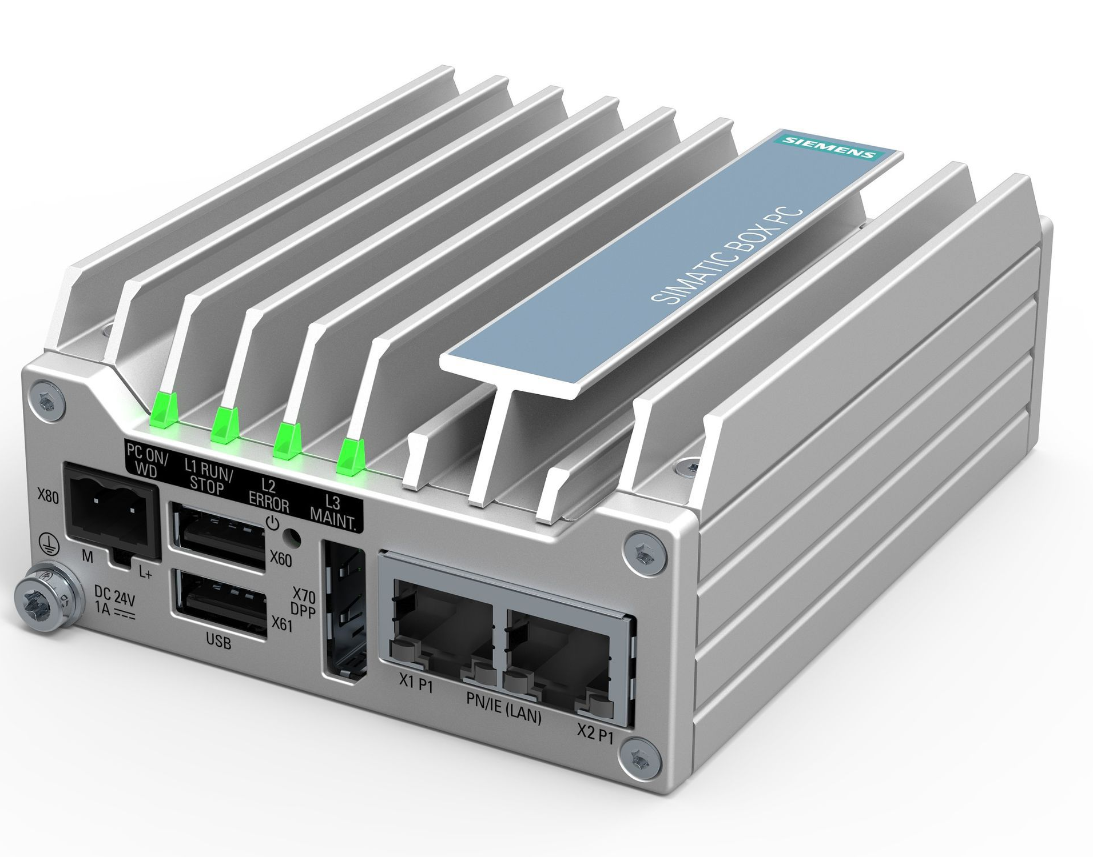
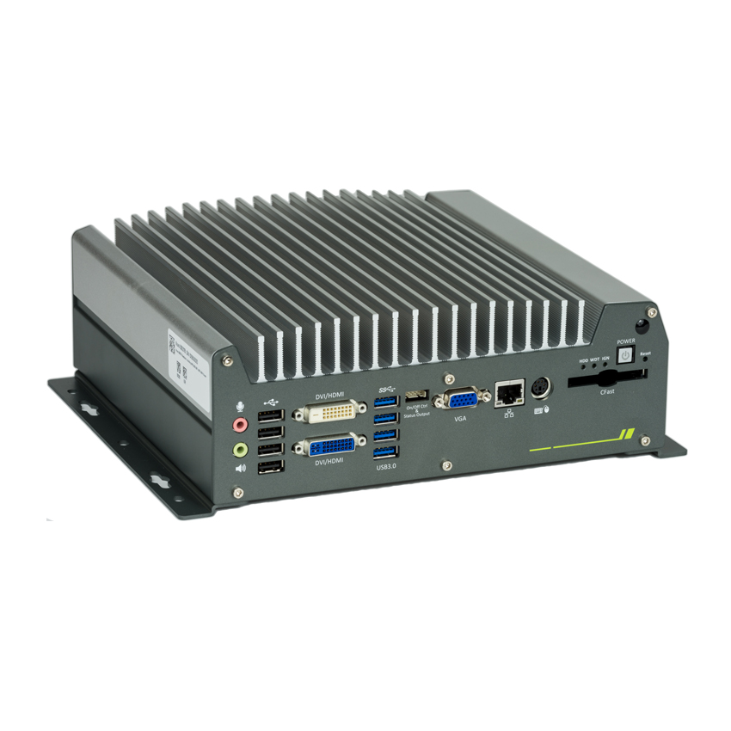
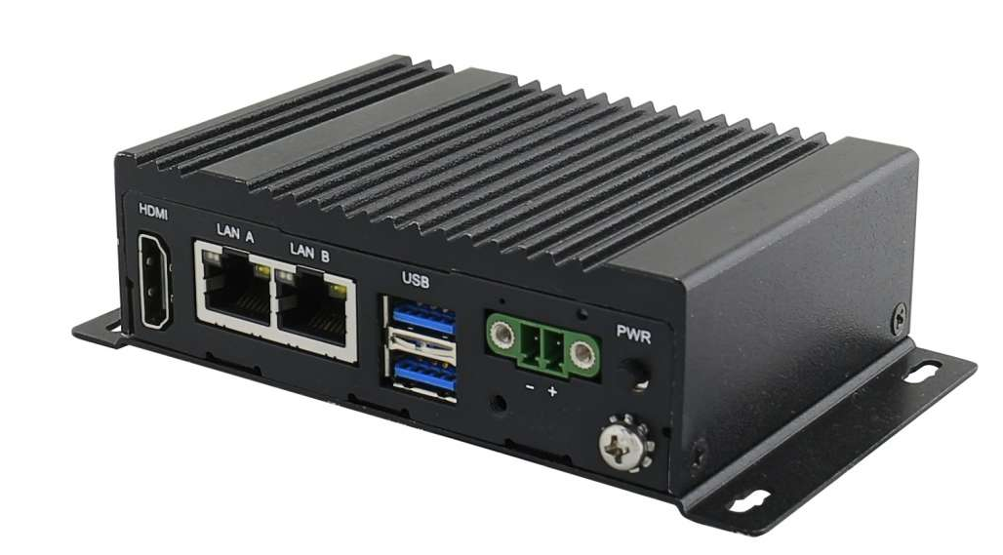
Nuvo-5000E
SIMATIC IPC127E
Nuvo-3000
EACIL20

Slide 4
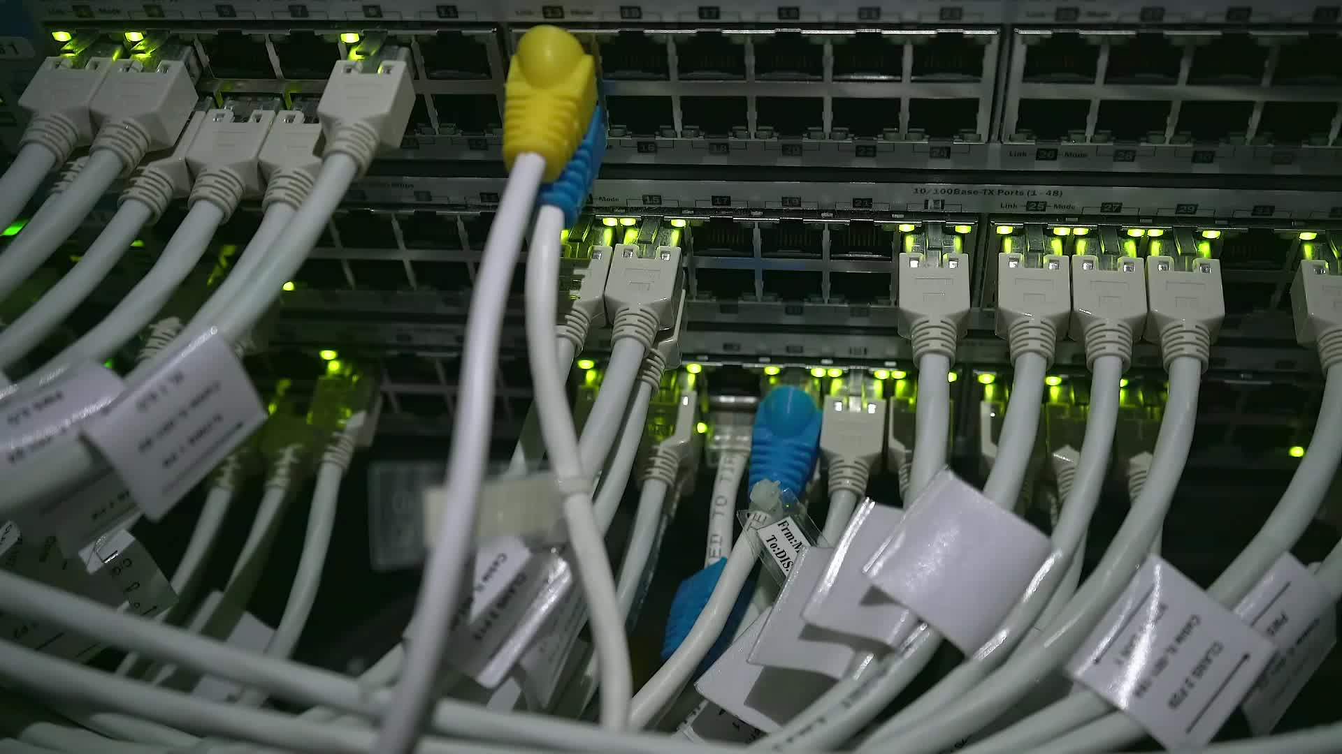
PLC
An industrial computer that monitors thestate of input devices and makesdecision based on logic to control output.
Pros:
Fast Speed
Low Cost
Easy to Program
Cons:
Fixed Circuit Operation

Slide 5
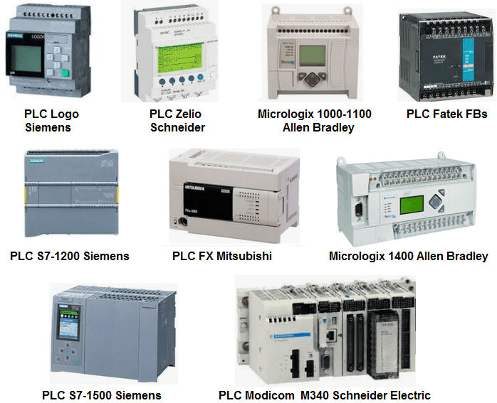

Slide 6
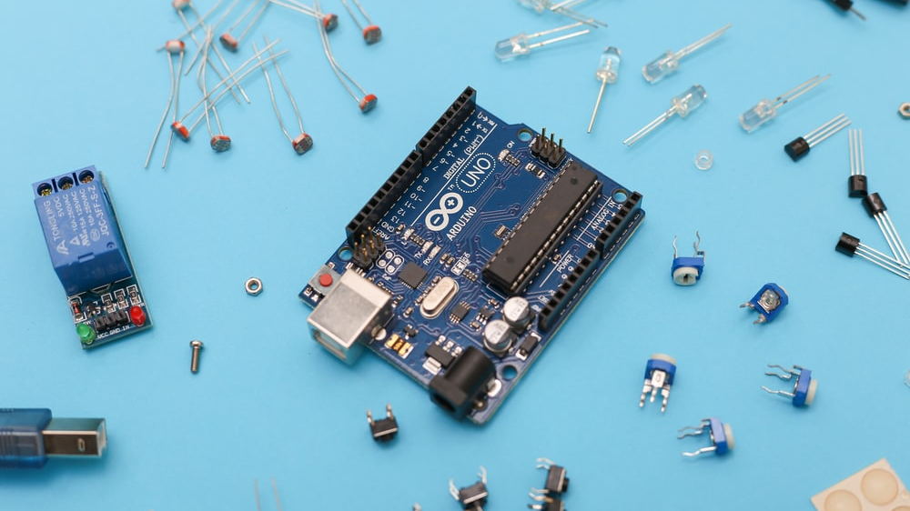
MICROCONTROLLER
A low-cost and small computer or chip that usually used as embedded system.
Pros:
Very Low Cost
LessPower Usage
Portable
Cons:
Low Processing Power

Slide 7

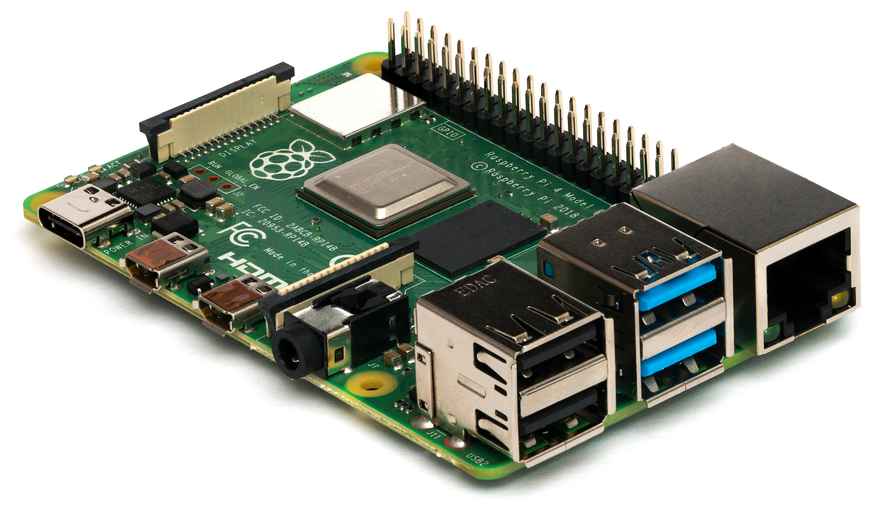
Raspberry Pi 4
Arduino UNO

Slide 8

EDGE AI CONTRLLER
Combination of both Edge Computing and AI, it runs task such asmachine learning directly on edge devices
Pros:
Fast Speed
Secure
Low Latency
Cons:
Requires a lot of storage capacity
Advanced infrastructure

Slide 9
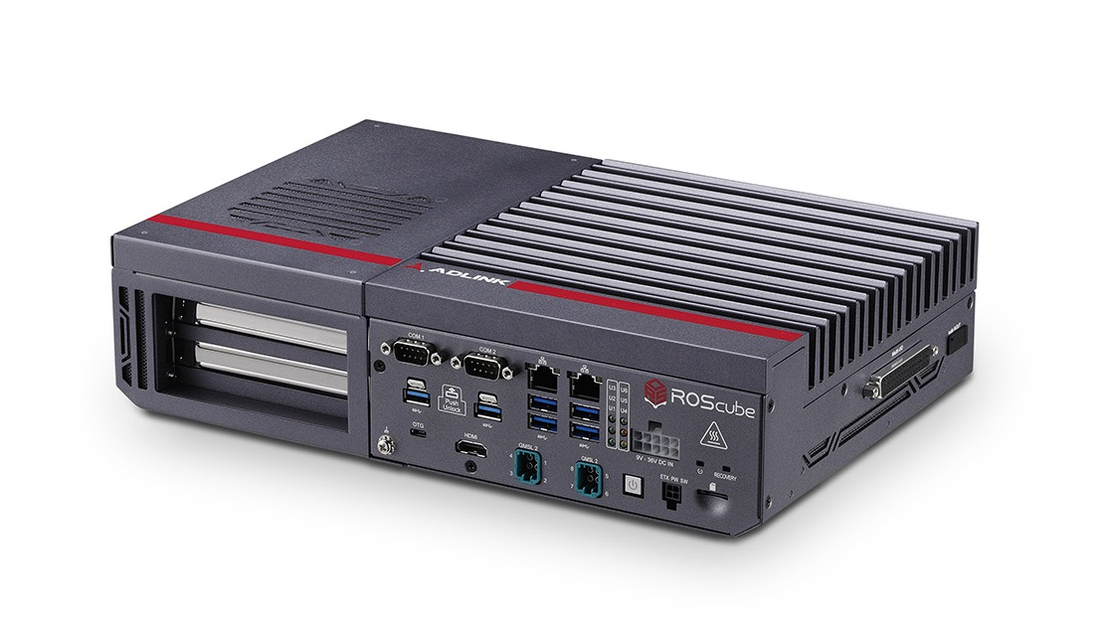
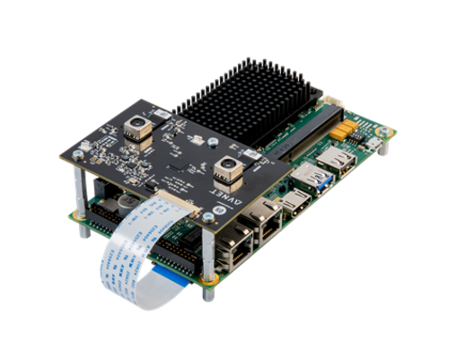
ROScube-X
Avnet Edge AI Development Kit

Slide 10
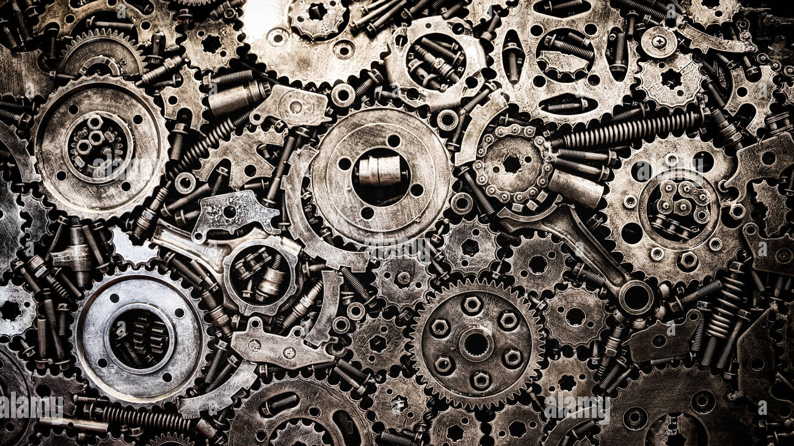
MOTOR CONTROLLER
Control a motor based on instruction or input given by controller.
Pros:
High Efficiency
Precise
Cons:
High Cost

Slide 11
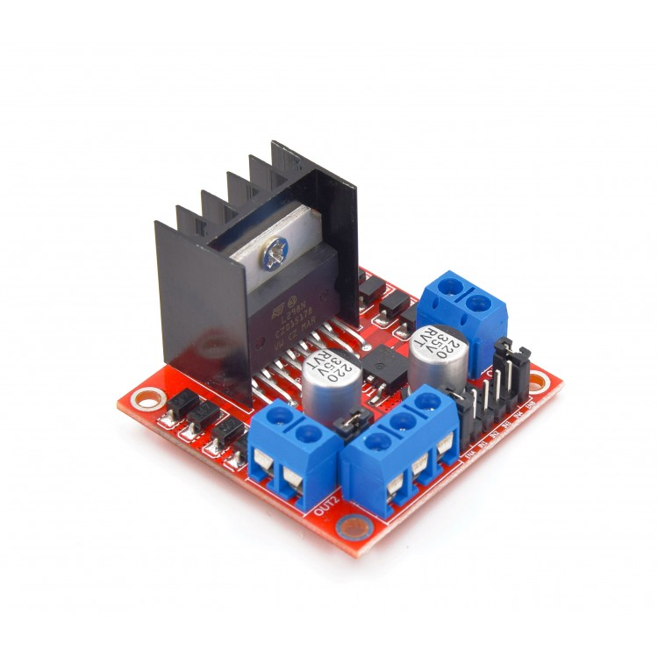
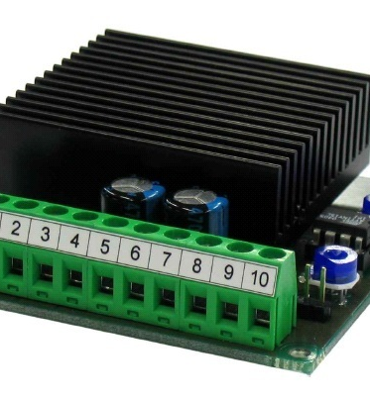
L298N
EM-176

